Slide 1
The Evolution of Storytelling/Writing Timeline

Slide 2
B.C.E/B.C. and C.E/A.D.
What do you think they mean?

Slide 3
B.C.E. and C.E.
B.C.E. – Before the common era
C.E. – Common Era (and after…)
What is the Common Era?

Slide 4
B.C. and A.D.
The terms anno Domini(AD) and before Christ (BC) are used to label or number years in the Julian and Gregorian calendars.
The term anno Domini is Medieval Latin, which means in the year of the Lord but is often translated as in the year of our Lord.

Slide 5
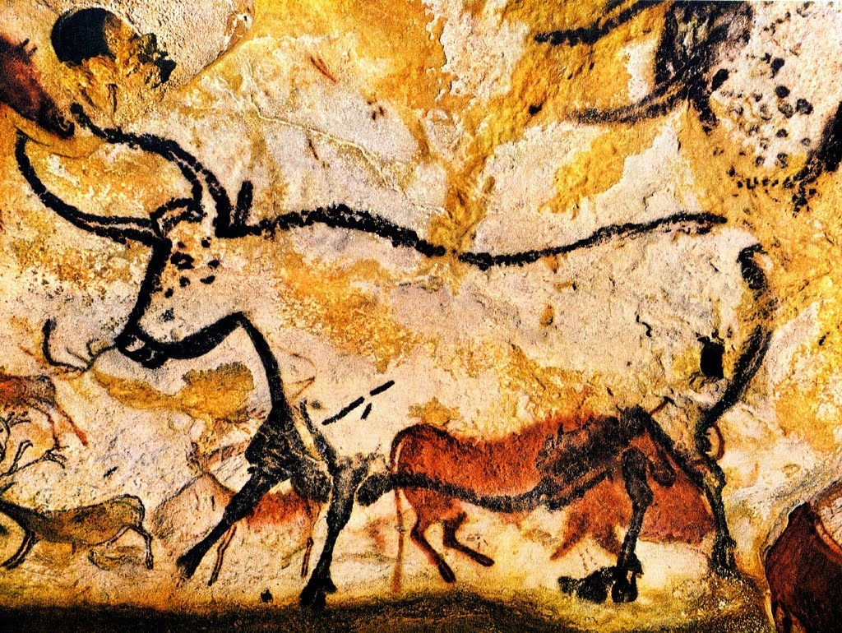
Pre 3800 B.C.E.
Lascaux 17, 300 years old

Slide 6
3000 B.C.E

Slide 7
3800 B.C.E.

Slide 8
2500 B.C.E

Slide 9
1800 B.C.E

Slide 10
1200 B.C.E

Slide 11
1200 B.C.E

Slide 12
1100 B.C.E

Slide 13
700 B.C.E

Slide 14
550 B.C.E

Slide 15
200 B.C.E

Slide 16
100 C.E.

Slide 17
400-1500 C.E.

Slide 18
1450 C.E.

Slide 19
1500’s-1600’s C.E.

Slide 20
1800’s

Slide 21
Early 1900’s

Slide 22
1900-1950

Slide 23
1950-Present

