Slide 1
Short Story Analysis

Slide 2
Learning Goals:
To consider questions to ask while reading, to examine short story plot structure
Minds on: Poetry word sort
Action: Questions to ask while reading
Short story #1: The Flowers
Modeled annotation
Consolidation: What personal connection can you make to this story?

Slide 3
Developing Character
Writers have available to them a variety of methods to reveal their characters. While inexperienced writers often rely on simply TELLING the reader what a character is like, more accomplished writers prefer to SHOW what a character is like.

Slide 4
How an author reveals a character:
What a character says.
What a character does or does not do.
What a character dreams or thinks.
What others say about the character.
How others react to the character.
How the character is described.

Slide 5
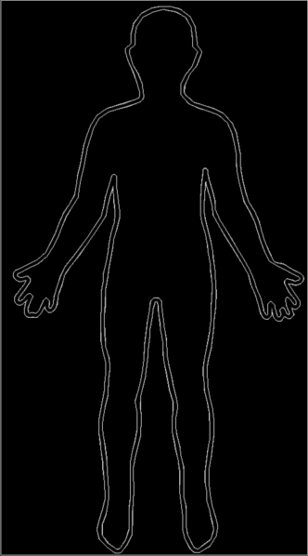
Character Mapping!
Use the body image to create your first character map. Use the “how an author reveals a character” slide to help you fill out your map!

