Slide 1
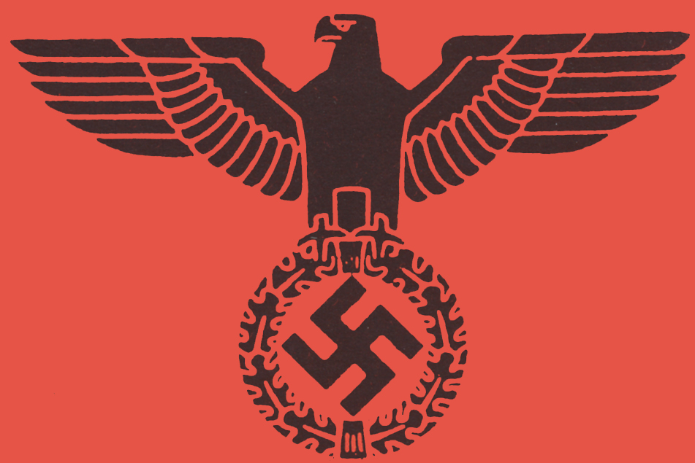
What Do We Already Know?
Hitler took power in…?
The term for hatred of the Jewish people is called…?
The book Hitler wrote while in prison is called…?
Which means…?

Slide 2
THE HOLOCAUST

Slide 3
And I said nothing…
In Germany They first came for the communists and I didn’t speak up because I wasn’t a communist. Then they came for the Jews, and I didn’t speak up because I wasn’t a Jew. Then they came for the trade-unionists, and I didn’t speak up because I wasn’t a trade unionist. Then they came for the Catholics, and I didn’t speak up because I was a Protestant. Then they came for me–– and by that time no one was left to speak up.
-- Pastor Martin Niemoller, 1945

Slide 4
So who would get arrested?
Anyone seen as a political threat
Democrats, communists, opposing party members
Anyone caught or suspected of making jokes about the Nazi party (if it was about Hitler, you were executed)
Those who rejected Nazi ideas or refused military service
Homosexuals
accusing someone of this was a common tactic used by Nazis to discredit someone
People of Roma (Gypsy) decent
Physically or mentally disabled people
Jewish people

Slide 5
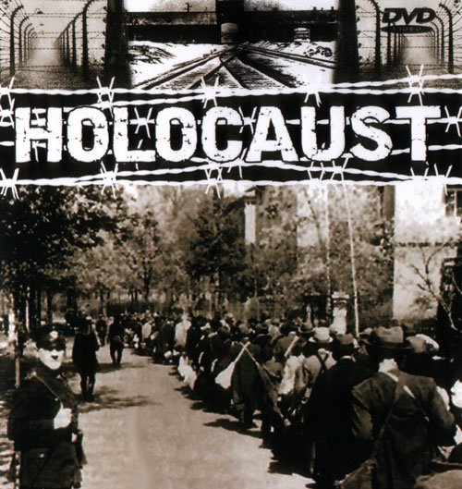
Stages of Genocide
In 1997 Gregory Stanton defined the Eight Stages of Genocide as:
1. Classification
2. Symbolization
3. Dehumanization
4. Organization
5. Polarization
6. Preparation
7. Extermination
8. Denial

Slide 6
Classification and Segregation
This is the rise of “anti-Semitism” – the hatred of the Jewish people
It creates an “us vs. them” feeling in Germany by using the Jews as scapegoats
This also allows for intense nationalism

Slide 7
The Nuremberg Laws
The Nuremberg Laws (1935) were designed to establish a defined German state and promote hate towards Jewish citizens in Germany.
Some notable features included:
Marriage and relationships between Germans and Jews was prohibited (The Law for the Protection of German Blood and Honour)
German-born Jews were stripped of their citizenship (The Reich Citizenship Law)

Slide 8
The Star of David
The Star of David is a common symbol of the Jewish faith
It was used throughout the Holocaust to identify Jews
Other Nazi targets were gypsies, homosexuals, Communists, other political “enemies”

Slide 9
Identification in the Camps
Yellow Star (of David) – Jewish
Red Triangle - political prisoners
Green Triangle – habitual criminals – “The Kapos”
Purple Triangle – Religious dissidents including Jehovah’s Witness, Bible Students etc.
Black Triangle – deemed “asocial” including the mentally ill, mentally disabled, alcoholic, the homeless, intellectuals, prostitutes, pacifists, “work shy”
Pink Triangle – Gay victims
Brown Triangle – Roma Peoples (Gypsies)
Blue Triangle – Immigrant Forced Labourers

Slide 10
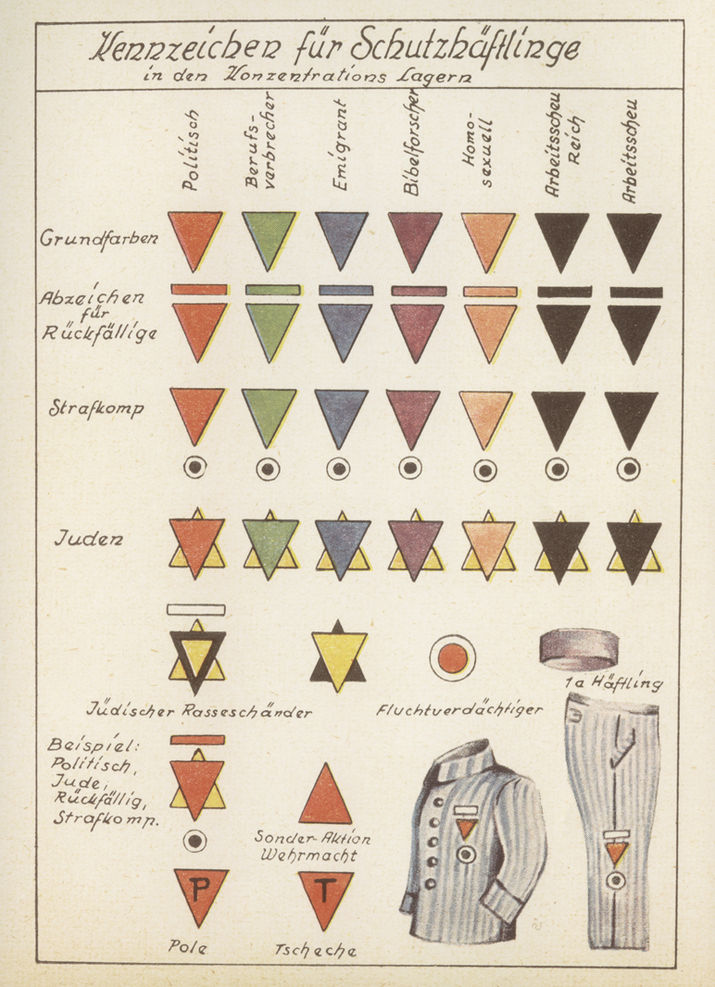

Slide 11
There were also combined identifying badges in the camps seen in this picture
Bars were added if you were a repeat offender
Black circles were added for prisoner battalions
Yellow triangles were added to denote “Jewish and…”
Black triangles were added to yellow stars to denote “race defilers”
Letters were added to show which country someone came from (using the German first letter of the county’s name)

Slide 12
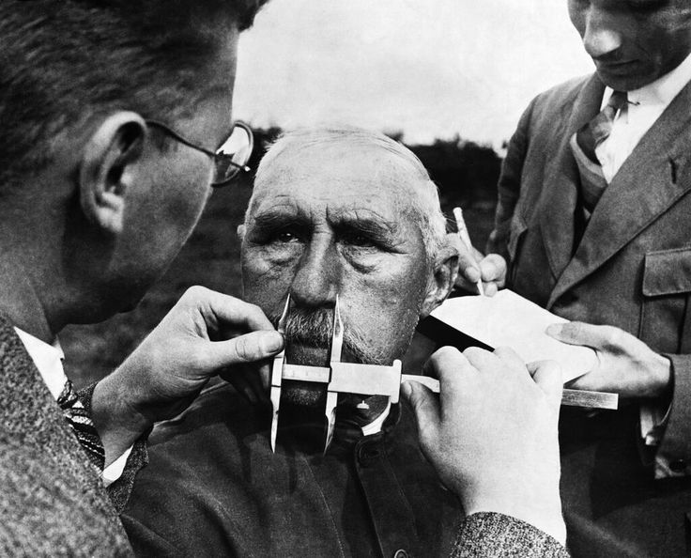
Dehumanization – Rules and Laws
By dehumanizing the humanity of “the other,” it somehow becomes accepted

Slide 13
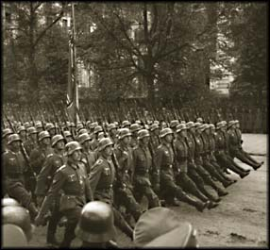
Dehumanization – Rules and Laws
Boycott of Jewish businesses
Removal of Jewish holidays from the calendar
Jews had to carry identification
They were banned from attending cultural events
A curfew was put in place

Slide 14
Kristallnacht
“The Night of the Broken Glass” – This marked the next level of the Holocaust
It started when a Polish student shot a German diplomat (Nov. 7 1938)
Hitler immediately organized a pogram – organized killing – for Germany and Austria

Slide 15
Kristallnacht
Over 7500 Jewish businesses were looted and destroyed
Over 170 synagogues were burned
Between 20,000 – 30,000 Jews were arrested and sent to concentration camps

Slide 16
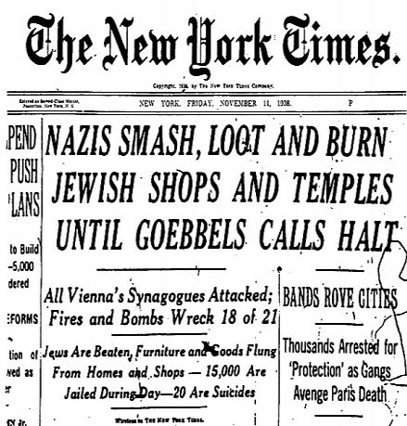
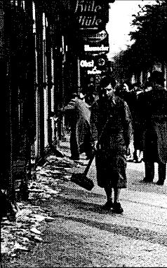

Slide 17
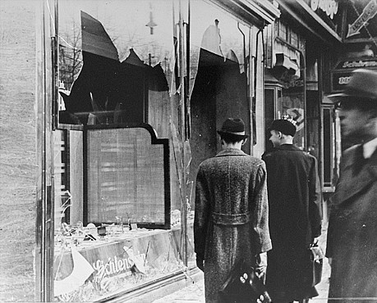
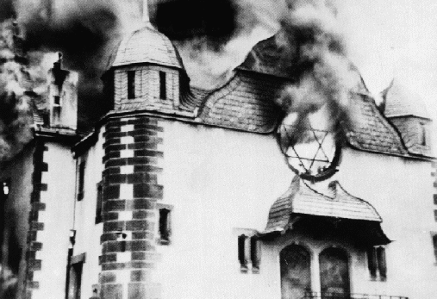
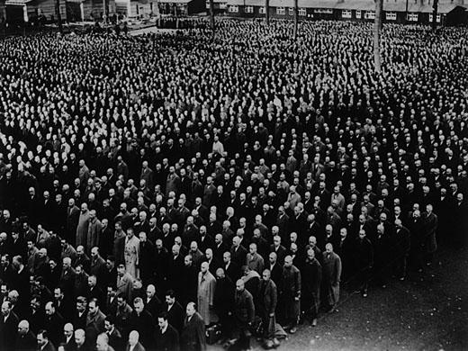

Slide 18
Organization and Polarization – The Ghettoes
A walled area within a city to contain the Jewish population
Conditions horrible; food is limited
Ghettoes also provided a source of slave labour
Warsaw Ghetto is approx 1016 acres for 500,000 people

Slide 19
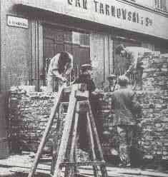
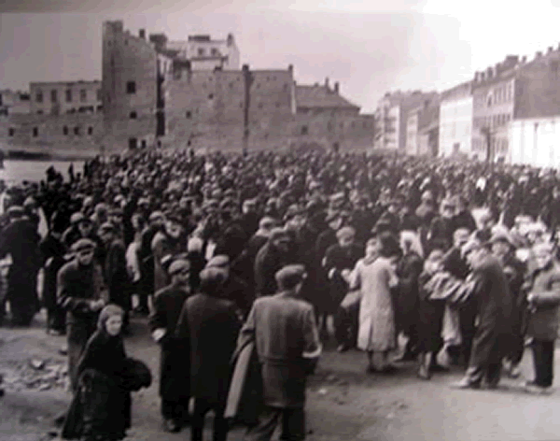
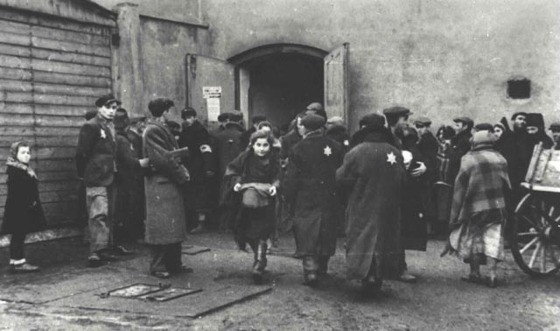
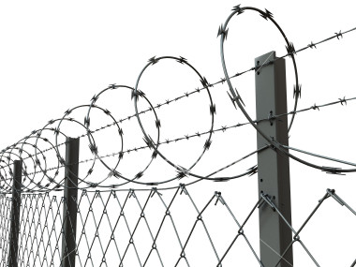

Slide 20
Quote Analysis
“One of the most surprising side-effects of this war is the clinging to life, the almost total absence of suicides. People die in great numbers of starvation, the typhus epidemic or dysentery, they are tortured and murdered by the Germans in great numbers, but they do not escape from life by their own desire. On the contrary, they are tied to life by all their senses, they want to live at any price and to survive the war. The tensions of this historic world conflict are so great that all wish to see the outcome of the gigantic struggle and the new regime in the world, the small and the great, old men and boys. The old have just one wish: the privilege of seeing the end and surviving Hitler.” (Warsaw Ghetto Diary: Avraham Levin, June 5, 1942)

Slide 21
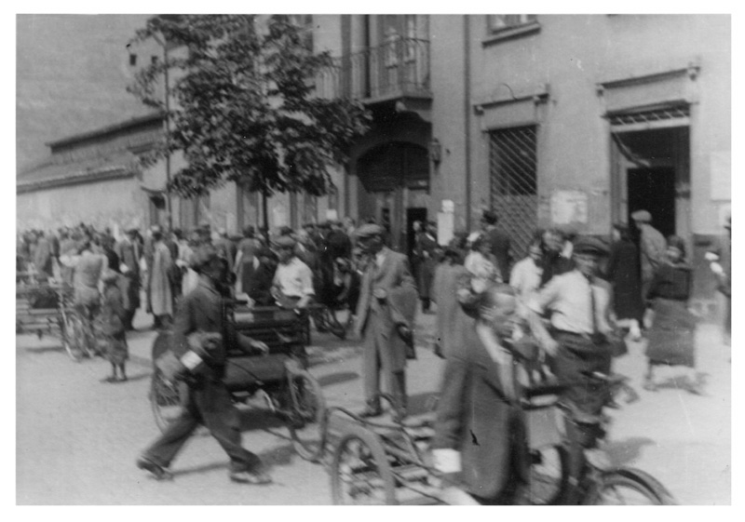
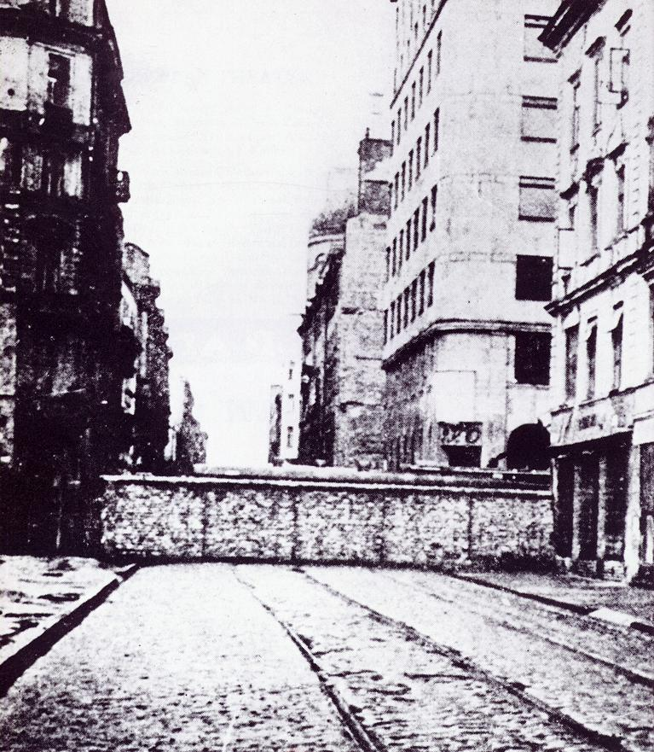
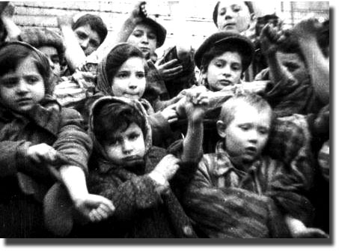

Slide 22
Quote Analysis
“The ghetto replied with armed struggle. The Jewish Fighting Organization opened a war of the weak against the strong. With scant forces, few arms and little ammunition, without water, blinded by smoke and fire, the Jewish fighters defended streets and individual houses. In the dusk they withdrew step by step, more because of the fire that had taken hold in the close-built houses than because of the enemy who was equipped with modern military arms. They considered it a victory if a part of those imprisoned in the ghetto were able to escape; it was a victory in their eyes to die while their hands still grasped arms....” (Yad Vashem Archives, 1943)

Slide 23
The Warsaw Ghetto Uprising
April 19 – May 19, 1943
Hitler announced all surviving Jews in the ghettoes would be taken to the camps
When the Germans began to deport those left the resistance began

Slide 24
The Warsaw Ghetto Uprising
750 resistors with handguns and 17 rifles faced more than 2000 Nazis
The Nazi general ordered the ghetto burned
The Jews held out for an amazing 27 days

Slide 25
The Warsaw Ghetto Uprising
300 Germans were killed
7000 Jewish fighters were also killed
Everyone else was captured and taken to the camps

Slide 26
Think Share
Write down the moment in your life you were most scared.
What was it that made you scared in that moment?
How did you get over that fear?
Did you legitimately feel that you were threatened or that your life was in danger?

Slide 27
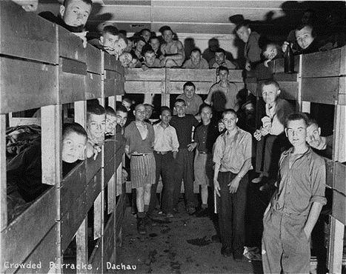
Preparation - The Camps
Originally, camps were occupied by prisoners to work for the German war effort
The first camp was Dachau (1933) outside of Munich
Upon arrival at the camps prisoners were subjected to “selection”
There were two types of camps: work camps and death camps

Slide 28
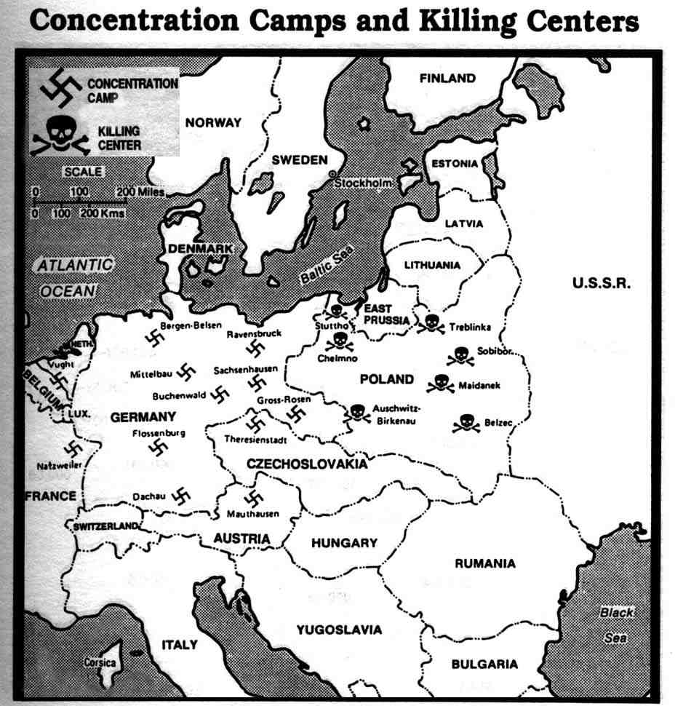

Slide 29
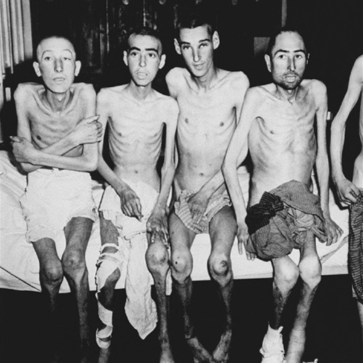
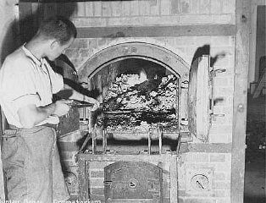
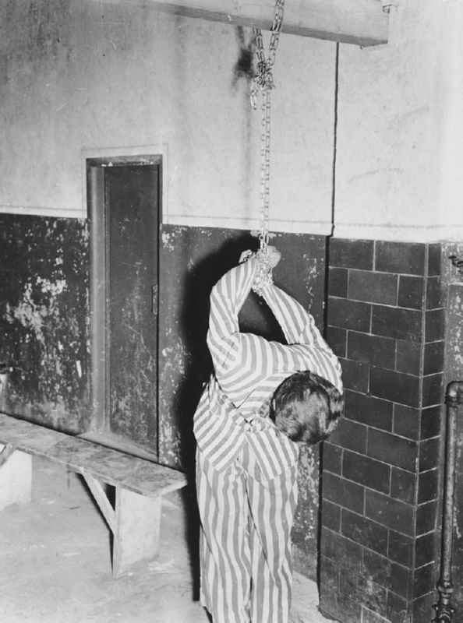
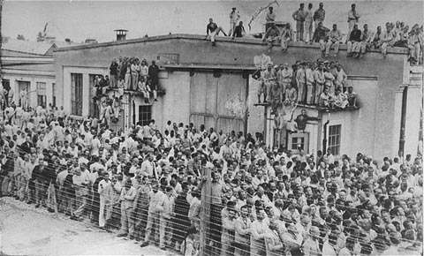

Slide 30
Auschwitz
“The Fuhrer has ordered that the Jewish question be solved for once and for all, and we, the SS, are to implement that order.” (Rudolf Hoess)
The largest and most infamous extermination camp. Auschwitz used both gas chambers and crematoria
Estimates of the number killed at Auschwitz vary between 2 – 4 million
As with most camps, Auschwitz had the ominous gate saying “Arbeit Macht Frei” – Work Will Set you Free

Slide 31
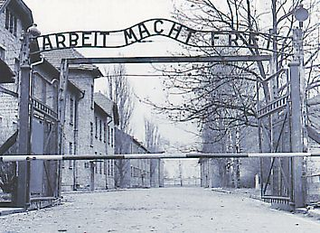
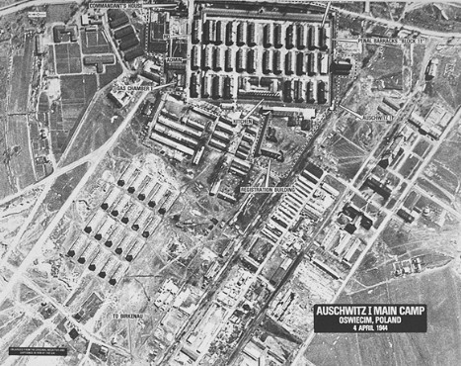

Slide 32
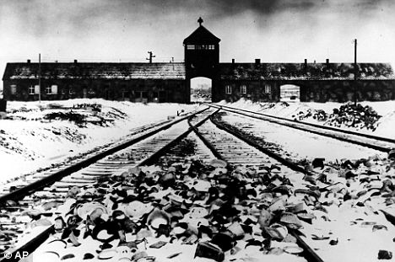

Slide 33
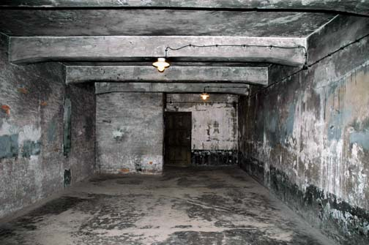
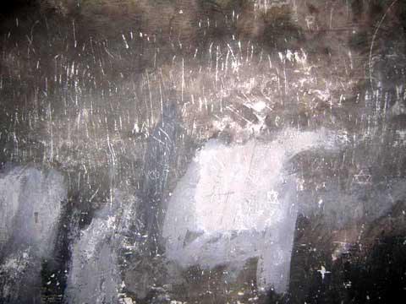

Slide 34
Extermination – The Final Solution
This was the systematic “liquidation” of the ghettoes to death camps
It also included mobile killing units
In the final days of the war Jews were executed or marched from the camps to “hide the evidence”

Slide 35
Joseph Mengele
Known as the “Angel of Death”, he was responsible for selection at Auschwitz
“Medical experiments” included pressure chambers, freezing people to death, intentionally infecting disease, and sadly more

Slide 36
Denial – The End of the War
The first deniers were the Nazis – they tried to hide their actions in any way possible
Denial continues through neo-Nazi groups, the KKK, and others
"The opposite of love is not hate, it's indifference. The opposite of art is not ugliness, it's indifference. The opposite of faith is not heresy, it's indifference. And the opposite of life is not death, it's indifference." (Elie Wiesel)

Slide 37
The War Crimes Trials
Starting with the Nuremberg Trials, Nazi officials were tried for most of the 1940’s
Many Nazis fled Europe in hopes of escaping trial
That said, 1000’s of Nazi war criminals were executed, jailed or committed suicide after the war

Slide 38
Final Thoughts

Slide 39
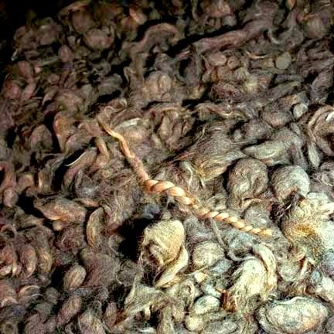

Slide 40
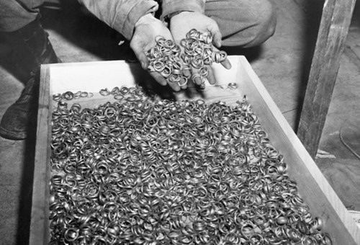

Slide 41
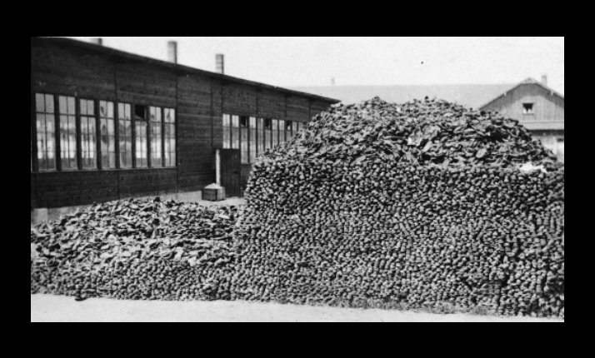

Slide 42
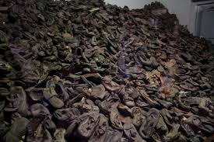

Slide 44
