Slide 1
D-Day: The Beginning of the End

Slide 2
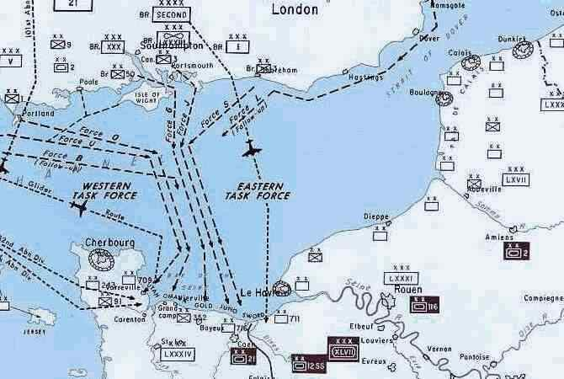
The Plan
This happened on June 6, 1944
The goal was to penetrate “Fortress Europe” and push the Germans back
The official name was Operation Overlord

Slide 3
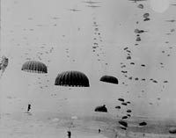
The Attack
This was a combined Allied effort – US, British and Canadian
This used air, sea and land forces
It began with paratroopers at 2:30 a.m. and forces started invading the beaches at 6:30

Slide 4
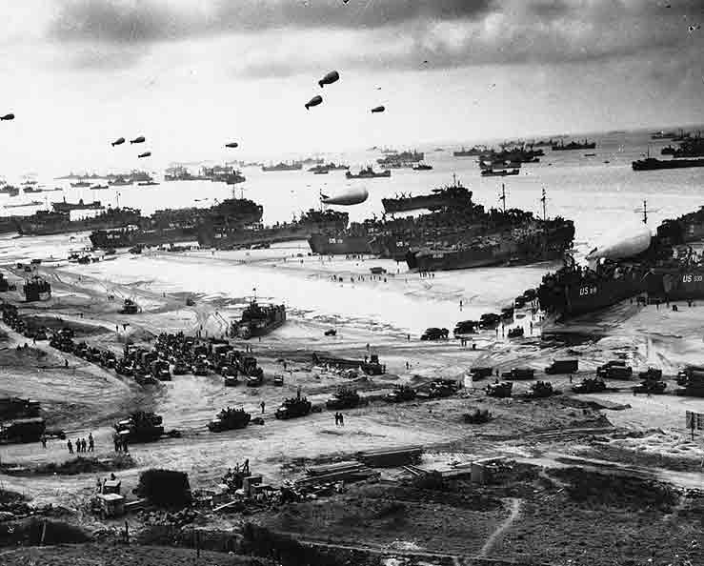

Slide 5
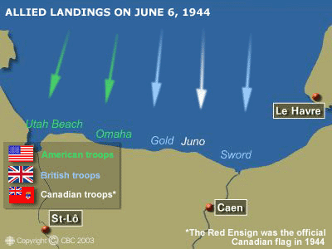
What Did Canada Do?
We gave paratroopers, soldiers, over 100 naval ships and airplanes
We landed at JUNO BEACH
We were the only Allied force to meet objective for the day – Take the beach and gain territory

Slide 6
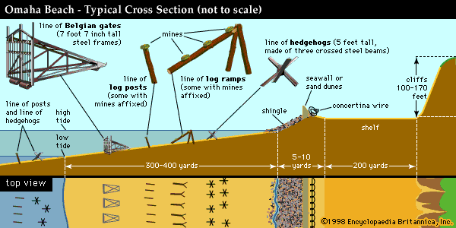

Slide 7
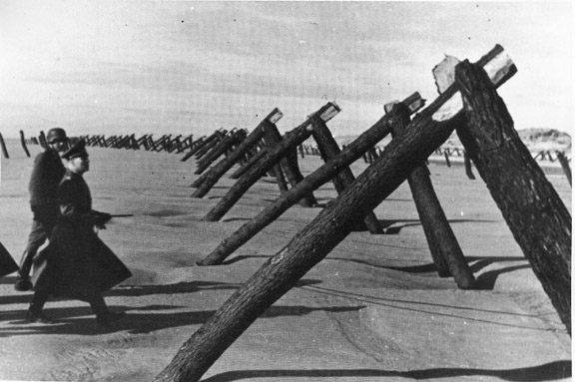

Slide 8
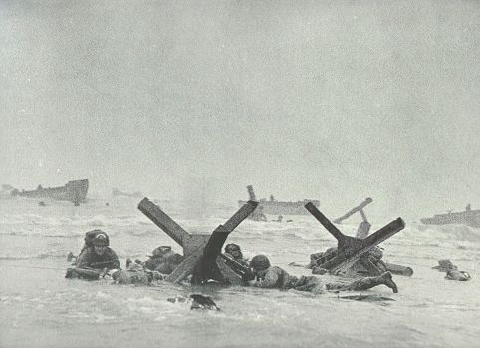

Slide 9
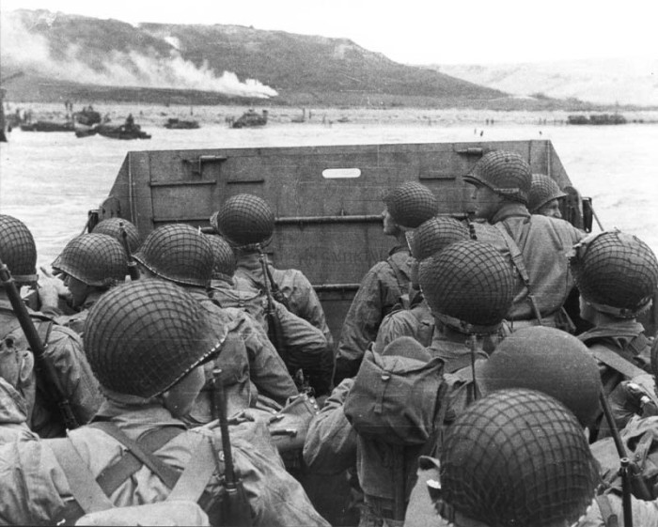

Slide 10
Overall Effort and Impact
Over 156 000 Allied troops landed on D-Day
Roughly 30 000 were Canadian
Within a month 1 million Allied soldiers had landed
The Liberation of Europe had begun – This was The Beginning of the End for Nazi Germany

