Slide 1
Act I, Scene v

Slide 2
Act I, Scene v
Setting
“The battlements”
Significantly, away from Marcellus and Horatio; Hamlet and the ghost are alone
The ghost finally identifies himself as being old Hamlet (“I am thy father’s spirit” – line 9)
The ghost is being punished
He must go back to “sulf’rous and tormenting flames” (line 3)
He is “Doomed for a certain term to walk the night, / And for the day confined to fast in fires, / Till the four crimes done in [his] days of nature / Are burnt and purged away” (lines 10-13)
This sounds like the Catholic idea of purgatory
Hamlet will play upon this idea later when he cannot murder Claudius while Claudius is praying (Claudius “took [Hamlet’s] father grossly, full of bread, / With all his crimes broad blown, as flush as May” – III, iii, 80-81)

Slide 3
Hamlet - genre of revenge tragedy
unlike any other revenge tragedy as more concerned with thought and moral questioning than with bloody action.
Even in his first encounter with the ghost, Hamlet questions appearances of surroundings and worries whether he can trust his perceptions, doubting the authenticity of his father’s ghost and its tragic claim.
Contemplative to the point of obsession, Hamlet’s decision to feign madness, ostensibly in order to keep the other characters from guessing the motive for his behavior, will lead him at times perilously close to actual madness.
It is impossible to say for certain whether or not Hamlet actually does go mad, and, if so, when his act becomes reality.
(We have already seen that Hamlet, though thoughtful by nature, also has an excitable streak, which makes him erratic, nervous, and unpredictable.)

Slide 4
The notion of revenge is introduced in this scene
Hamlet is, above all else, a play about revenge; this is the play’s most basic structure
The ghost uses the word first, in line 7: “So art thou to revenge, when thou shalt hear”
Again, he comes back to this word in line 25: “Revenge his foul and most unnatural murder”
The word “unnatural” touches on the idea of Elizabethan cosmology again (cf. – Macbeth, Julius Caesar – you’re not allowed to kill rulers! It messes up the universe!)
Hamlet instantly agrees to do what needs to be done, but this is of course ironic: the rest of the play will be Hamlet delaying his revenge

Slide 5
Act 1, Scene v
The ghost uses the word first, in line 7: “So art thou to revenge, when thou shalt hear”
Again, he comes back to this word in line 25: “Revenge his foul and most unnatural murder”
The word “unnatural” touches on the idea of Elizabethan cosmology again (cf. – Macbeth, Julius Caesar – you’re not allowed to kill rulers! It messes up the universe!)
Hamlet instantly agrees to do what needs to be done, but this is of course ironic: the rest of the play will be Hamlet delaying his revenge

Slide 6
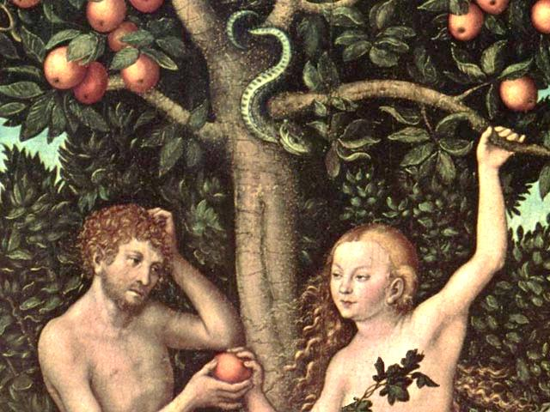
Act 1, Scene v
The ghost reveals he was murdered by his brother.
orchard with sleeping King Hamlet = innocent and peaceful state,
Claudius is described via the metaphor of the serpent, (Shakespeare using imagery designed to evoke biblical Garden of Eden (Book of Genesis - betrayal of humanity)
Eve is persuaded to violate God’s injunction against eating the fruit from the Tree of Knowledge (through deceit of serpent) – consequences being exiled The King’s alleged murder vs murder of Abel by brother Cain, (also in Genesis)
Biblical allusions would have resonated deeply with Shakespeare’s audiences, imparting even greater gravity to the ghost’s story.

Slide 7
Details of the murder
Apparently, the story was that old Hamlet was bitten by a snake
The ghost tells Hamlet that Claudius was the murderer
“The serpent that did sting thy father’s life / Now wears his crown” (lines 39-40)
Claudius is the serpent: evil, cunning, good with words, like the serpent in the Garden of Eden, able to tempt…Gertrude?
Questions:
Did Claudius kill old Hamlet to get Gertrude?
Did Gertrude know about the murder?
Was anything going on between Claudius and Gertrude before old Hamlet was killed?
Branagh’s film hints at this
There has even been speculation that they have had an affair for decades, and that there is an outside chance that Hamlet is Claudius’ son
Hamlet has a very interesting response to this: “O my prophetic soul!” (line 40)
Hamlet has suspected that “something is rotten in the state of Denmark” for a while
This explains his dislike of Claudius in Scene ii

Slide 8
Claudius killed old Hamlet with poison, putting it into the old king’s ear
Symbolic
Claudius is a great politician, a great talker
He “whispers poison,” so to speak
Hamlet is told to avenge his father, but specifically not to do anything to Gertrude (“Taint not thy mind, nor let thy soul contrive / Against thy mother aught” – lines 85-86)
Interesting, given nastiness of ghost when discussing Claudius’ seduction of her
ghost sees Gertrude as victim; cannot see her as willing participant in her own seduction (Rather naïve view of women)
Hamlet will be much nastier about women and their weakness (“frailty”) later in the play
Hamlet actually says something bad about his mother right away (“O most pernicious woman!” – line 105)

Slide 9
Hamlet: The time is out of joint. O cursed spite, / That ever I was born to set it right! (lines 188-189)
The time = the state, the country, the political situation
Out of joint = broken, wrong…diseased? (“Something is rotten in the state of Denmark”)
Hamlet sees himself as being “born to set [things] right”
It is his fate, his destiny
He is a hero, a fact that he has attempted to deny a couple of times so far
He does not want to be a hero (this may be his real tragedy – Bloom)

